Slide 1


Slide 2
Verily Firaun exalted himself in
the land and made its people
in sects, weakening a party
among them, slaying their sons
and letting their girls live.
Verily he was of the corrupters
28:4
Notes:
Leader should not exalt himself, should not divide people into sects, should not weaken one group, should not deprive them of their rights and should not do corruption.
There are number of explanations of transformational leadership. My concept is reverse of style mentioned in ayat.
Transformational leadership is concerned with emotions, values, ethics, standards, and long-term goals. Lets judge my concept on this standard.

Slide 3
Leadership
Chapter 9 –
Transformational Leadership
Northouse, 4th edition

Slide 4
Overview
Transformational Leadership (TL) Perspective
A Model of Transformational Leadership
Transformational Leadership Factors
Full Range of Leadership Model
The Additive Effects of TL
Other Transformational Leadership Perspectives
How Does the Transformational Approach Work?

Slide 5
INTRODUCTION
Latest approach
Charisma and affective elements
1/3 research
Other fields
Intrinsic motivation and followers development
Notes:
Latest and current apch. Since 1980s
Gives more attention to charisma and affective elms of leadership
A research found in 2001 that 1/3 research was on tsfl and charism leadership.
The research not limited to traditional fd like mgmt. but extended to nursing, medical, education fds also
Popularity is probably because of its emphasis on intrinsic motivation and followers dev, which fits todays work groups.

Slide 6
Transformational Leadership
Description
Process - TL is a process that:
  changes and transforms individuals
  frequently incorporates charismatic and visionary leadership
Influence - TL involves an exceptional form of influence that moves followers to accomplish more than what is usually expected of them
Notes:
A cadet is different person and an officer is different person
Influence not status quo
Charismatic is a person who possesses special traits that attract, inspire, or fascinate other people

Slide 7
Transformational Leadership
Description
Core elements - TL
  is concerned with emotions, values, ethics, standards, and long-term goals
  includes assessing followers’ motives, satisfying their needs, and treating them as full human beings
Encompassing approach – TL
  describes a wide range of leadership influence
    Specific: one-to-one with followers
    Broad: whole organizations or entire cultures
  follower(s) and leader are inextricably bound together in the transformation process
Notes:
Encompassing means wholesome

Slide 8
Types of Leadership Defined by James McGregor Burns (1978)
Transformational Leadership
  Emphasized the difference between sources of authority
    Two types of leadership
      Transactional – contractual management
      Transformational (transforming) – “occurs when one or more persons engage with one another in such a way that leaders and followers raise one another to higher levels of motivation and morality” (1978)
      Pseudotransformational – personalized leadership rather than others
Notes:
Txl- Focuses on exchanges. bulk of leadership models. Eg politician who promises no new taxes, or manager who promises promotion to those who surpass others, Teacher giving grades if students study
Tsfl ldr is attentive to followers needs and motives and tries to help followers to reach their goals. Eg Rayon White an aid worker who raised people awareness. A manager who attempts to change company’s corporate values to reflect a more humane std of fairness and justice. In the process both leader and followers emerge with a stronger and higher set of values. WHAT ABOUT HITLER AND SADDAM? They were transforming people, isn’t it? Yes but in negative way. For this the term used is Pseudotransformational, which means leaders who are self-consumed , exploitative and power oriented with wrapped values.

Slide 9
Types of Leadership Defined
Burns (1978)
Focuses on the
exchanges
that occur
between leaders
and their followers
No new taxes = votes.
Sell more cars = bonus.
Turn in assignments = grade.
Surpass goals = promotion.
…
The exchange dimension is so common that you can observe it at all walks of life.
TRANSACTIONAL

Slide 10
Types of Leadership Defined
Burns (1978)
Leader is attentive to the needs and motives of followers and tries to help followers reach their fullest potential.
Process of
engaging with others
to create a connection
that increases
motivation
and morality in both the
leader and the follower
Quaid & Mohandas Gandhi – raised the hopes and demands of millions of their people and in the process were changed themselves
TRANSFORMATIONAL

Slide 11
Types of Leadership Defined
Burns (1978)
Process of
engaging with others
to create a connection
that increases
motivation
and morality in both the
leader and the follower
Organizational example - A manager attempts to change his/her company’s corporate values to reflect a more humane standard of fairness & justice – In the process both manager & followers may emerge with a stronger & higher set of moral values
TRANSFORMATIONAL

Slide 12
Types of Leadership Defined
Burns (1978)
Leaders who are
  transforming but in a negative way
  self-consumed, exploitive, power-oriented, with warped moral values
includes leaders like
  Adolph Hitler
  Saddam Hussein
Focuses on the
leader’s
own interests rather than the interests of their followers
PSEUDOTRANSFORMATIONAL

Slide 13

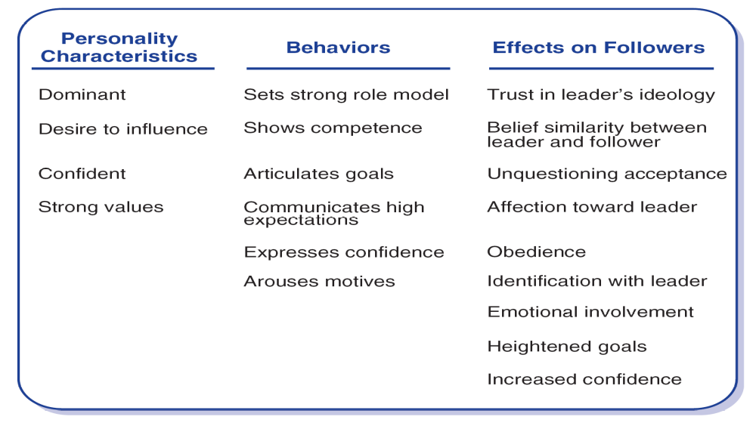
Theory of Charismatic Leadership (House, 1976)

Slide 14
Transformational Leadership & Charisma
Definition
Charisma - A special personality characteristic that gives a person superhuman or exceptional powers and is reserved for a few, is of divine origin, and results in the person being treated as a leader (Weber, 1947)
Charismatic Leadership Theory (House, 1976)
  Charismatic leaders act in unique ways that have specific charismatic effects on their followers
Notes:
At the same time House published theory of charismatic ldrship. Got lot of attention. Described in same way as tsfl if not synonym.
Charisma is a fire, a fire that ignites followers’ energy and commitment, producing results above and beyond the call of duty. Charisma is the product of three elements: (1) a spark-a leader who has charismatic qualities, (2) flammable material-followers who are open or susceptible to charisma, and (3) oxygen-an environment conducive to charisma. Charisma is not the spark. It is not the flammable material. And it is not the oxygen. Charisma is the product of their union. Charisma resides in the relationship between a leader who has charismatic qualities and those of his or her followers who are open to charisma, within a charisma-conducive environment.

Slide 15
Theory of Charismatic Leadership
(Shamir, House, & Arthur, 1993)
Later Studies
Charismatic Leadership –
  Transforms follower’s self-concepts; tries to link identity of followers to collective identity of the organization
    Forge this link by emphasizing intrinsic rewards & de-emphasizing extrinsic rewards
    Throughout process leaders
      Express high expectations for followers
      help followers gain sense of self-confidence and self-efficacy

Slide 16
Model of Transformational Leadership
Bass (1985)
Transformational Leadership Model
  Expanded and refined version of work done by Burns and House. It included:
    More attention to follower’s rather than leaders’ needs
    Suggested TL could apply to outcomes that were not positive
    Described transactional and transformational leadership as a continuum
  Extended House’s work by:
      Giving more attention to emotional elements & origins of charisma
      Suggested charisma is a necessary but not sufficient condition for TL

Slide 17

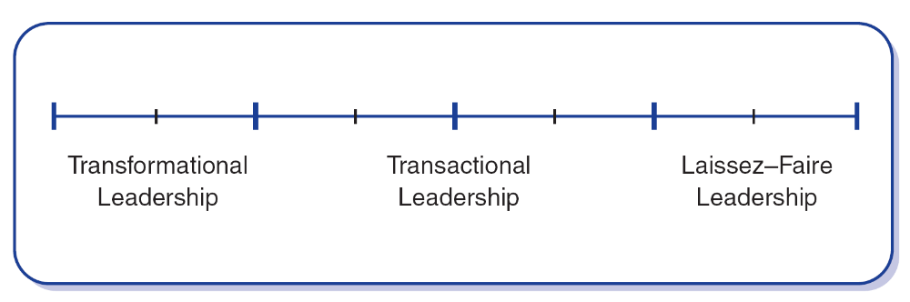
Model of Transformational Leadership
Bass (1985)
TL motivates followers beyond the expected by:
raising consciousness about the value and importance of specific and idealized goals
transcending self-interest for the good of the team or organization
addressing higher-level needs

Slide 18
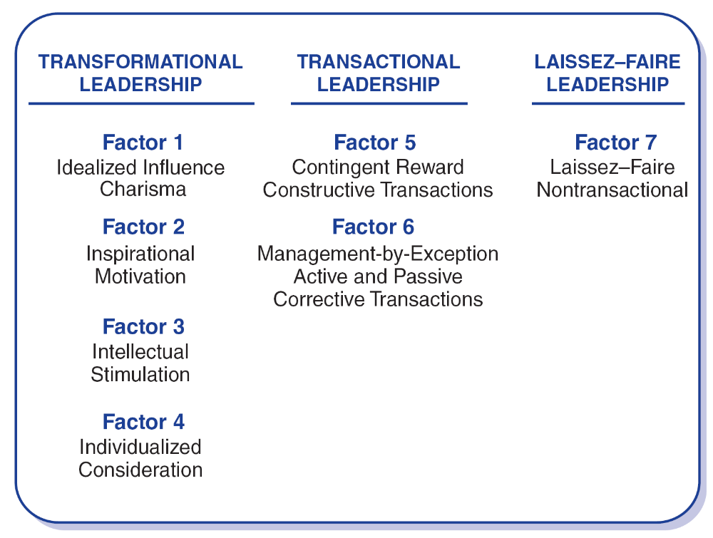
Transformational Leadership Factors
Leaders who exhibit TL:
have a strong set of internal values & ideals
are effective in motivating followers to support greater good over self-interest

Slide 19
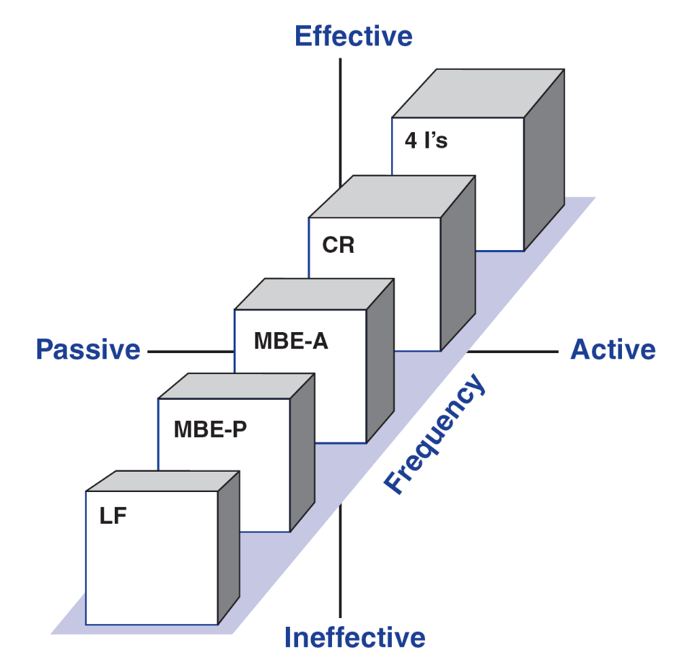
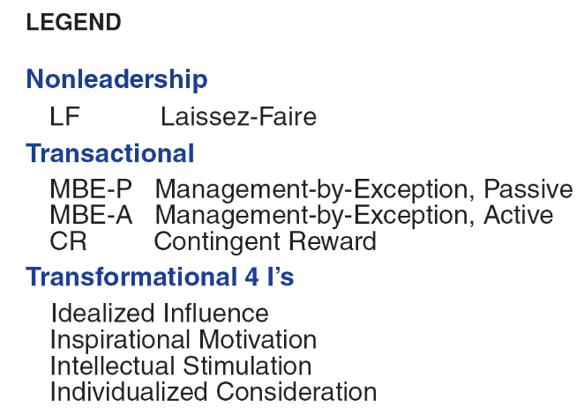
Full Range of Leadership Model

Slide 20
Transformational Leadership Factors
The 4 “I”s
Idealized Influence
Charisma
Describes leaders who act as strong role models for followers
  followers identify with leaders and emulate them
Leader’s have high standards of ethical and moral conduct
    followers deeply respect & trust L’s
    L’s provide a vision and sense of mission

Slide 21
Transformational Leadership Factors
The 4 “I”s
Inspirational Motivation
Leaders who communicate high expectations to followers
  inspiring followers through motivation to commitment and engagement in shared vision of the organization
  L’s use symbols & emotional appeals to focus group members to achieve more than self-interest; team spirit promoted

Slide 22
Transformational Leadership Factors
The 4 “I”s
Intellectual Stimulation
Stimulates followers to be creative and innovative
Challenge their own beliefs and values those of leader and organization
Leader supports followers to
  try new approaches
  develop innovative ways of dealing with organization issues

Slide 23
Transformational Leadership Factors
The 4 “I”s
Individualized Consideration
Leaders who provide a supportive climate in which they listen carefully to the needs of followers
Leader’s act as coaches and advisors encouraging self-actualization

Slide 24
Transactional Leadership Factors
Transactional Leaders –
Leaders do not individualize the needs of subordinates nor focus on their personal development
Exchange things of value with subordinates to further both’s agendas

Slide 25
Transactional Leadership Factors
Contingent Reward
The exchange process between leaders and followers in which effort by followers is exchanged for specified rewards
Management by Exception
Leadership that involves corrective criticism, negative feedback, and negative reinforcement
  Two forms
    Active - Watches follower closely to identify mistakes/rule violations
    Passive - Intervenes only after standards have not been met or problems have arisen

Slide 26
Nonleadership Factor
Laissez-Faire
The absence of leadership
A hands-off, let-things-ride approach
Refers to a leader who
  abdicates responsibility
  delays decisions
  gives no feedback, and
  makes little effort to help followers satisfy their
  needs

Slide 27
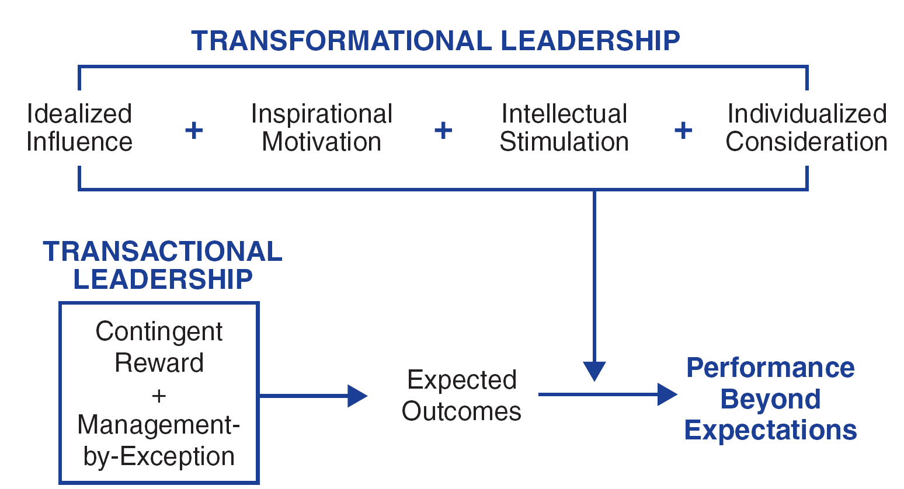
Additive Effect of
Transformational Leadership

Slide 28
Other Transformational Perspectives
Bennis & Nanus (1985)
Four Leader Strategies in Transforming Organizations
Clear vision of organization’s future state
TL’s social architect of organization
Create trust by making their position known and standing by it
Creatively deploy themselves through positive self-regard

Slide 29
Other Transformational Perspectives
Kouzes & Pozner (1987, 2002)
Model consists of 5 fundamental practices
  Enable leaders to get extraordinary things accomplished
Model the Way
  Exemplary leaders set a personal example for others by their own behavior
Inspire a Shared Vision
  Effective leaders inspire visions that challenge others to transcend the status quo to do something for others

Slide 30
Other Transformational Perspectives
Kouzes & Pozner (1987, 2002)
Model consists of 5 fundamental practices
Challenge the Process
  Leaders are like pioneers – are willing to innovate, grow, take risks, & improve
Enable Others to Act
  Leaders create environments where people can feel good about their work & how it contributes to greater community
Encourage the Heart
  Leaders use authentic celebrations & rituals to show appreciation & encouragement to others

Slide 31
How Does the Transformational Leadership Approach Work?
Focus of Transformational Leadership
Strengths
Criticisms
Application

Slide 32
Transformational Leadership
Focus of Transformational Leaders
Overall Scope
TLs empower and nurture followers
TLs stimulate change by becoming strong role models for followers
TLs commonly create a vision
TLs require leaders to become social architects
TLs build trust & foster collaboration
Describes how leaders can initiate, develop, and carry out significant changes in organizations

Slide 33
Strengths
Broadly researched. TL has been widely researched, including a large body of qualitative research centering on prominent leaders and CEOs in major firms.
Intuitive appeal. People are attracted to TL because it makes sense to them.
Process-focused. TL treats leadership as a process occurring between followers and leaders.
Expansive leadership view. TL provides a broader view of leadership that augments other leadership models.
Emphasizes follower. TL emphasizes followers’ needs, values, and morals.
Effectiveness. Evidence supports that TL is an effective form of leadership.

Slide 34
Criticisms
Lacks conceptual clarity
  Dimensions are not clearly delimited
  Parameters of TL overlap with similar conceptualizations of leadership
Measurement questioned
  Validity of MLQ not fully established
  Some transformational factors are not unique solely to the transformational model
TL treats leadership more as a personality trait or predisposition than a behavior that can be taught
TL is elitist and antidemocratic
Suffers from heroic leadership bias
TL is based primarily on qualitative data
Has the potential to be abused

Slide 35

Application
Provides a general way of thinking about leadership that stresses ideals, inspiration, innovations, and individual concerns
Can be taught to individuals at all levels of the organization
Able to positively impact a firm’s performance
May be used as a tool in recruitment, selection, promotion, and training development
Can be used to improve team development, decision-making groups, quality initiatives, and reorganizations
The MLQ helps leaders to target areas of leadership improvement

Slide 36


8/2/2012

Slide 37


پاکستان زندہ باد

